Slide 1


PYTHON
Lecture 53

Slide 2

Today’s Agenda
File Handling
The seek( ) Method
Appending In A File
Using with Statement

Slide 3
The seek( ) Method
To reset the internal file pointer we use the seek() method.
Syntax:
seek(offset, whence).
whence is optional, and determines where to seek from.
If whence is 0, the bytes/letters are counted from the beginning.
If it is 1, the bytes are counted from the current cursor position.
If it is 2, then the bytes are counted from the end of the file.
If nothing is put there, 0 is assumed.
offset describes how far from whence that the cursor moves.

Slide 4
seek( ) Examples
f.seek(45,0)
would move the cursor to 45 bytes/letters after the beginning of the file.
f.seek(10,1)
would move the cursor to 10 bytes/letters after the current cursor position.
f.seek(-77,2)
would move the cursor to 77 bytes/letters before the end of the file (notice the - before the 77)
Special Note:
Python 3 only supports text file seeks from the beginning of the file.
If we try to call seek() with non-zero value for offset from cur or end then the code will throw an exception called:
UnsupportedOperation: can't do nonzero end-relative seeks
Thus for seek() to work , the file must be a binary file like image file, music file etc.

Slide 5
Exercise
Write a program to create the file message.txt in d:\ of your computer
Now ask the user to continuously type messages and save them in the file line by line.
Stop when the user strikes an ENTER key on a new line
Finally display how many lines were written in the file.
Now read and display the contents of the file line by line.
Finally also display total number of lines read from the file.
Also properly handle every possible exception the code can throw

Slide 6
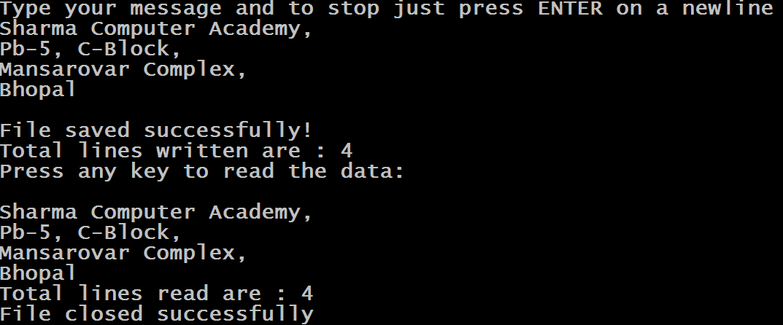
Sample Output

Slide 7
Solution
try:
fobj=open("d:\\message.txt","w+")
text=input("Type your message and to stop just press ENTER on a newline\n")
lines=0
while True:
if text=="":
break
lines+=1
fobj.write(text+"\n")
text=input()
print("File saved successfully!")
print("Total lines written are :",lines)
print("Press any key to read the data:")
input()
fobj.seek(0)
lines=0

Slide 8
Solution
while True:
text=fobj.readline()
if text=="":
break
lines+=1
print(text,end="")
print("Total lines read are :",lines)
except FileNotFoundError as ex1:
print("Could not open the file: ",ex1)
except OSError as ex2:
print("Error in file I/O: ",ex2)
finally:
if 'fobj' in globals():
fobj.close()
print("File closed successfully")

Slide 9
Appending Data In a File
We can use "a" mode to append data to end of the file.
When we open the file in “a” or “a+” mode , the internal file pointer is placed at the end while writing the new data.
Thus , the new text we write does not overwrite the previous contents of the file.
Moreover if the file is not present it gets created.

Slide 10
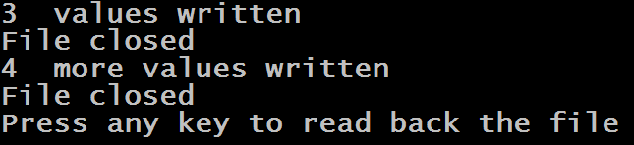
Example
days=["Sunday","Monday","Tuesday","Wednesday","Thursday","Friday","Saturday"]
fobj=None
try:
fobj=open("d:\\days.txt","a")
items=0
for day in days[:3]:
fobj.write(day+"\n")
items+=1
fobj.close()
print(items," values written")
print("File closed")
items=0
fobj=open("d:\\days.txt","a")
for day in days[3:]:
fobj.write(day+"\n")
items+=1
fobj.close()
print(items," more values written")
print("File closed")
print("Press any key to read back the file")
input()

Slide 11
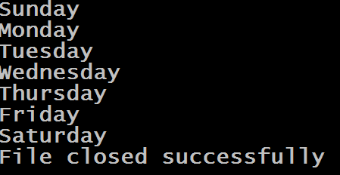
Example
fobj=open("d:\\days.txt","r")
for day in fobj:
print(day,end="")
except FileNotFoundError as ex:
print("Could not open the file: ",ex)
finally:
if fobj is not None:
fobj.close()
print("File closed successfully")

Slide 12
Using with Statement
Python also provides a nice shortcut for file handling using the with statement.
The following is the general form of the with statement when used with files.
with open(filename, mode) as file_object:
# body of with statement
# perform the file operations here

Slide 13
Important Points About with Statement
It automatically closes the file without requiring any work on our part.
The scope of file_object variable is only limited to the body of the with statement.
So , if we try to call read() or write() method on it outside the block we will get NameError.

Slide 14
Example
try:
with open("d:\\message.txt","r") as fin:
lines=0
for x in fin:
print(x,end="")
lines+=1
print("Total lines read are :",lines)
print("File closed successfully!")
except FileNotFoundError as ex:
print("Could not open the file: ",ex)

Slide 15
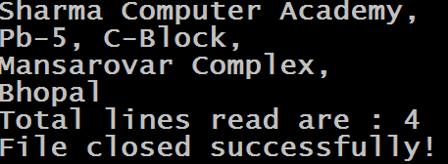
Sample Output

